Slide 1

CSE 8A – Introduction to Programming and Computational Problem Solving I
Lists
How to get help:
Class Website
https://sites.google.com/ucsd.edu/cse8afa23/home
Piazza for brief questions or logistic questions
Tutor Hours for help with homework/setting up computer To get help, use Autograder (directions on piazza)
Office Hours for homework/conceptual help
Slides based, in part, on materials from Dan Zingaro and Christine Alvarado.
Notes:
Welcome!

Slide 2
Which of the following best sums up your feelings about learning to program in Python?
Excited
Curious
Meh
Frustrated/Overwhelmed

Slide 3
Which of the following best sums how you're feeling about the quarter right now?
Excited
Curious
Meh
Frustrated/Overwhelmed

Slide 4
How do you like to use CoPilot in this course?
To write my code so I don't have to think too hard
As a partner to provide hints when I need it
As a last resort when I can't figure out the answer
I haven't really used CoPilot

Slide 5
Announcements
Homework 4 due next Monday at 10pm
Lab 4 is tomorrow, standard setup
Quiz 2 is in lab next week. Topics:
Loops, Strings, Lists
Reading files, basics of analyzing data

Slide 6
Learning Goals for Today
By the end of today’s lecture, you should be able to:
Trace and modify code that includes loops, lists, conditionals, and functions
Insert and remove from lists
Iterate over lists analyzing or changing their contents

Slide 7
Lists
I'm writing a program and I need to represent the names of all of my friends. Here's my first attempt:
friend1 = "Sara"
friend2 = "Eduardo"
friend3 = "Audrey"
print("My friends are:", friend1, friend2, friend3)
What's the problem here?

Slide 8
Lists vs. Strings
List | String
Sequence | Sequence
Stores anything | Stores characters
Mutable | Immutable
Can be nested | No nesting
Methods can modify | Methods cannot modify

Slide 9
List Basics
11
22
33
>>> lst = [11,22,33]
>>> lst
2
0
1
[11, 22, 33]

Slide 10
List Basics
11
22
33
>>> lst = [11,22,33]
>>> lst
2
0
1
[11, 22, 33]
>>> lst[1]
22

Slide 11
List Basics
11
22
33
>>> lst = [11,22,33]
>>> lst
2
0
1
[11, 22, 33]
>>> lst[1]
22
>>> lst[3]
Error – index out of range

Slide 12
Iterating over a List
11
22
33
>>> lst = [11,22,33]
>>> for i in lst:
… print(i)
0
1
2
11
22
33

Slide 13
Iterating over a List
11
22
33
>>> lst = [11,22,33]
>>> for i in lst:
… print(i)
0
1
2
11
22
33
>>> for i in range(0,len(lst)):
… print(i)
What does this code print?
Notes:
Talk about the fact this prints 0, 1, 2.

Slide 14
Iterating over a List
11
22
33
>>> lst = [11,22,33]
>>> for i in lst:
… print(i)
0
1
2
11
22
33
>>> for i in range(0,len(lst)):
… print(lst[i])
11
22
33
Notes:
Focus on using the index
Point out the value of the bottom loop as this is always a safe way of iterating through a list.

Slide 15
Loops and Lists
11
22
33
lst = [11, 22, 33]
for i in range(len(lst)):
lst[i] = lst[i] + 2 print(lst)
0
1
2
What does this code print?
A. [11, 22, 33]
B. [13, 24, 35]
C. The program has an error
D. None of the above
Notes:
B. This changes the list!

Slide 16
Loops and Lists
11
22
33
lst = [11, 22, 33]
for val in lst:
val = val + 2
print(lst)
0
1
2
What does this code print?
A. [11, 22, 33]
B. [13, 24, 35]
C. The program has an error
D. None of the above
Notes:
A. Wait, what?! Yep, it doesn’t change it. Show the memory model for why not.

Slide 17
Lists are MUTABLE
95
11
22
33
>>> lst = [11,22,33]
>>> lst[1]=95
0
1
2
>>> print(lst[1])
95
Notes:
Unlike strings, you can change the content of elements in a list.

Slide 18
Appending to a List
11
22
33
44
>>> lst = [11,22,33]
0
1
2
3
>>> lst.append(44)
>>> lst
[11, 22, 33, 44]
Notes:
I said at the start, lists are resizeable. This means we can append values to the end of the list. Let's see how this works. We'll start with our usual list

Slide 19
Deleting from a List
11
22
33
44
>>> lst = [11,22,33,44]
>>> lst.pop(2)
0
1
2
3
33
Notes:
You can add elements, but you an also remove them.
First, the pop method.

Slide 20
Lists and Loops
def nameme(lst):
val = 0
for i in lst:
if i > val:
val = i
return val
lst = [0, 10, 8, 12, 1, 3]
print ( nameme (lst) )
Computer Memory
What does this code print?
A. 0
B. 12
C. 3
D. The program goes into an infinite loop
E. None of the above
Notes:
Talk through key parts of functions: parameters, return, do a careful walkthrough of memory and introduce the stack and the heap

Slide 21
Recall: Strings are Immutable
String values are immutable
Immutable means “cannot change”
Methods therefore cannot change a string; they can only make new strings
Below, the string referenced by s is not modified; a new string is created, but it is immediately lost (since no variable refers to it)
s = 'hello'
s.upper()
print(s)

Slide 22
Shared references and Strings
Nothing weird happens when multiple variables refer to the same string.
>>> s = 'hello'
>>> t = s
>>> s.upper()
'HELLO'
>>> s
'hello'
>>> t
'hello'
>>> s = s.upper()
>>> s
'HELLO'
>>> t
'hello'
Notes:
Do a full memory model – point out that because strings are immutable you can’t change

Slide 23
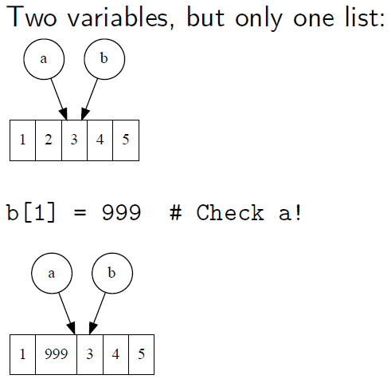
List Mutability
a = [1, 2, 3, 4, 5]
b = a # Shared reference!
Notes:
Do a full memory model – point out that because strings are immutable you can’t change

Slide 24
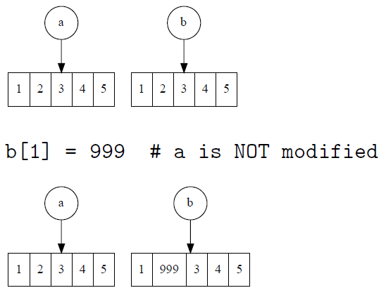
Copying a List
If you want to avoid the sharing behavior, create a second list:
a = [1, 2, 3, 4, 5]
b = list(a) # Or b = A[:]
Notes:
Do a full memory model – point out that because strings are immutable you can’t change

Slide 25
Functions: Strings and Lists
a = [11, 22, 33]
len: length of a sequence (i.e. number of elements)
len(a) # returns 3
min, max: minimum or maximum of sequence
min(a) # returns 11
max(a) # returns 33
Sum: sum of the elements in the list (doesn’t work on strings)
sum(a) # returns 66

Slide 26
Lists of Strings
'abc'
'defgh'
'i'
lst = ['abc', 'defgh', 'i']
lst[1] = lst[0][0]
print(len(lst) + len(lst[1]))
What is the output of this code?
A. 3
B. 4
C. 7
D. 8
E. No output; there is an error
0
1
2
Notes:
4 –
lst[1] = lst[0][0] sets lst[1] to be ‘a’
So len(lst) is 3; len(lst[1]) is 1

Slide 27
List Methods
Use dir([]) to get a list of list methods
Use help([].x) for help on method name x
L.append(element): add element to the end of L
L.extend(lst): add all elements of lst to the end of L
L.insert(index, element): insert element at index of L, pushing later elements forward
L.pop(): remove and return the element at the end of L
L.pop(index): remove and return the element at index of L
L.remove(element): remove first occurrence of element from L
L.sort(): sort the elements of L

Slide 28
List Methods
a = [2, 4, 6, 8]
a.pop(2)
a.remove(4)
What is the value of a after the code runs?
A. [2, 4]
B. [6, 8]
C. [2, 6]
D. [2, 8]
E. Nothing; the code produces an error

Slide 29
Summary
Python supports variables, conditionals, loops and strings
Loops are either “for” loops or “while” loops
Strings can be indexed (e.g., s[1]) to access chars
We need a clear understanding of these to be able to read code
Lists allow us to store data
They are mutable
There are many helpful functions and methods for lists
Notes:
Mention extension

